Slide 1
Prompt Engineering
Structure

Slide 2
Delimiters – Separating Data Clearly
What are Delimiters?
Delimiters are special symbols or characters used to separate different parts of a prompt. They help AI clearly distinguish between instructions, data, and examples.
Common delimiters include:
Triple quotes (""")
<<< >>>
XML or JSON tags

Slide 3
Example Without Delimiters
Prompt:
Summarize the following text. Here we explain how climate change affects agriculture. Climate change is causing unpredictable rainfall and crop damage. Species are disappearing because of climate change.
This prompt is confusing because instructions and data are mixed.

Slide 4
Example With Delimiters
Prompt:
Summarize the text below.
Text:
###
Here we explain how climate change affects agriculture.
Climate change is causing unpredictable rainfall and crop damage. Species are disappearing because of climate change.
###
Now AI clearly understands where the text starts and ends.

Slide 5
Using Triple Quotes
Prompt:
Summarize the text inside triple quotes.
“””
Artificial Intelligence is transforming healthcare through automation and predictive analytics. It is shaping the world in a way that is making positive difference in people lives.
“””
Here triple quotes separates instructions from text

Slide 6
Using Separator Lines
Prompt:
Analyze the data below and identify key trends.
---
Sales increased by 20% in Q1.
Sales dropped by 5% in Q2.
Sales remained same in Q3.
---

Slide 7
Using tags
Prompt:
Explain the following code
<python>
a=2
b=3
print(a+b)
</python>

Slide 8
Using tags
Prompt:
Classify the sentiment of the text inside the <review> tags as Positive, Negative, or Neutral.
<review>
I hated the customer service, but the product itself works perfectly. I am conflicted. </review>
<output>
Neutral
</output>
<review>
I hated the customer service
</review>
<output>
Negative
</output>
<review>
I loved the product
</review>
<output>
Positive
</output>

Slide 9
Why Delimiters are Important
Without delimiters, AI may get confused between:
Instructions
Input data
Using delimiters improves clarity, accuracy and parsing reliability

Slide 10
When to Use Delimiters
Delimiters are especially useful when:
Working with long text inputs
Handling structured data
Passing code snippets
Providing multiple examples
Preventing instruction mixing

Slide 11
2. Format Constraint – Forcing Structured Output
What is Format Constraint?
Format Constraint is a prompting technique where we force AI to provide output in a specific structure or format.
Common formats include:
JSON, CSV
Markdown
Tables
Bullet Points, tabular format
XML
Code Blocks

Slide 12
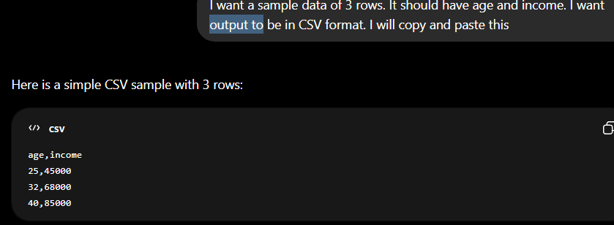
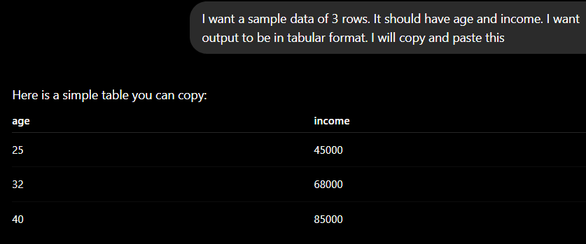

Slide 13
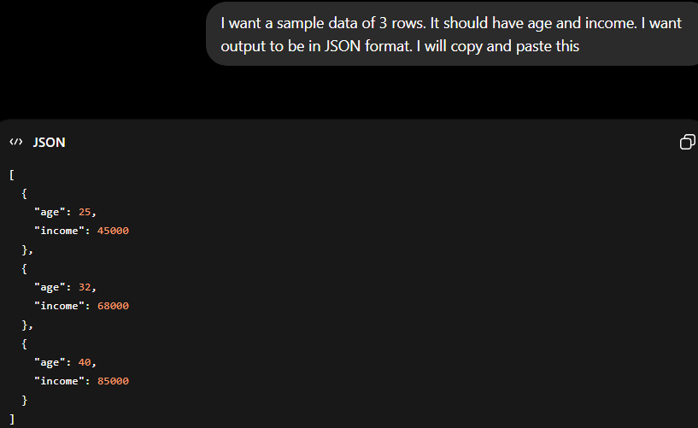

Slide 14

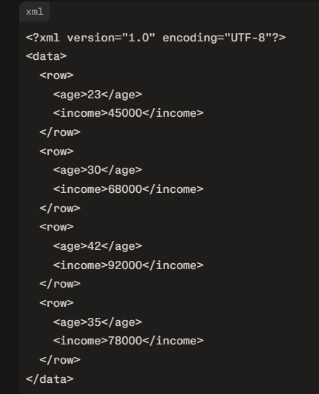

Slide 15
Example Without Format Constraint
Prompt:
I have uploaded a csv file. The file contains student data.
Provide student information for John, Age 20, Course AI.
AI might respond in random format.

Slide 16
Example With JSON Format Constraint
Prompt:
I have uploaded a csv file. The file contains student data.
Provide student information in JSON format.
Student Details:
Name: John
Age: 20
Course: AI
Expected Output From AI:
{
"name": "John",
"age": 20,
"course": "AI"
}

Slide 17
Example With Markdown Format
Prompt:
Explain Machine Learning in markdown format using headings and bullet points.
Example Output:
# Machine Learning
## What is Machine Learning?
- Machine Learning (ML) is a branch of Artificial Intelligence (AI).
- It allows computers to learn patterns from data.
- ML models make predictions or decisions based on input data.
---
## Why is Machine Learning Important?
- Helps automate complex decision-making.
- Used in real-world applications such as:
- Recommendation systems (Netflix, Amazon)
- Fraud detection in banking
- Speech recognition (Alexa, Siri)

Slide 18
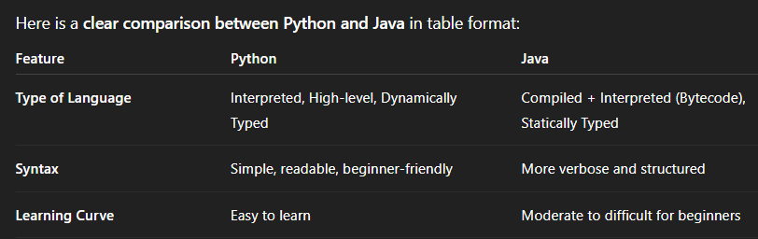
Example With Table Format
Prompt:
Provide comparison of Python and Java in table format.

Slide 19
Why Format Constraint is Important
Structured output helps:
Integrate AI output into applications
Automate workflows
Make data machine-readable
LLM
Model
{
“name”: “John”,
“age”: “39”
}
Web
application
ML
Model

Slide 20
When to Use Format Constraint
Use this technique when:
Building APIs
Exporting structured data
Automating reports
Developing AI applications

Slide 21
Combining above Techniques
These techniques work best when combined.
Example Combined Prompt
You are a professional data analyst who explains concepts clearly and formally.
Analyze the dataset below.
###
Sales increased by 15% in January.
Sales decreased by 3% in February.
Sales decreased by 1% in March.
###
Provide output in JSON format with fields:
- Trend
- Insight
- Recommendation

Slide 22
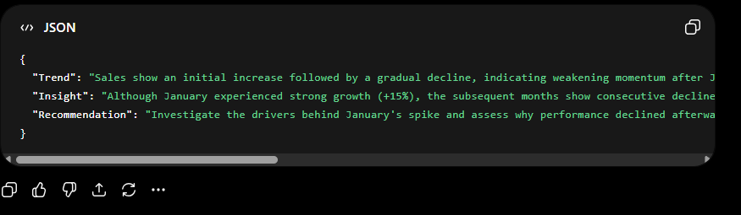
Combining above Techniques
{
"Trend": "Sales show an initial increase followed by a gradual decline, indicating weakening momentum after January.",
"Insight": "Although January experienced strong growth (+15%), the subsequent months show consecutive declines (-3% in February and -1% in March), suggesting that the initial boost was not sustained and demand may be stabilizing or weakening.",
"Recommendation": "Investigate the drivers behind January's spike and assess why performance declined afterward. Focus on strengthening customer retention strategies, optimizing marketing campaigns, and identifying seasonal or operational factors affecting February and March performance."
}

